Slide 1

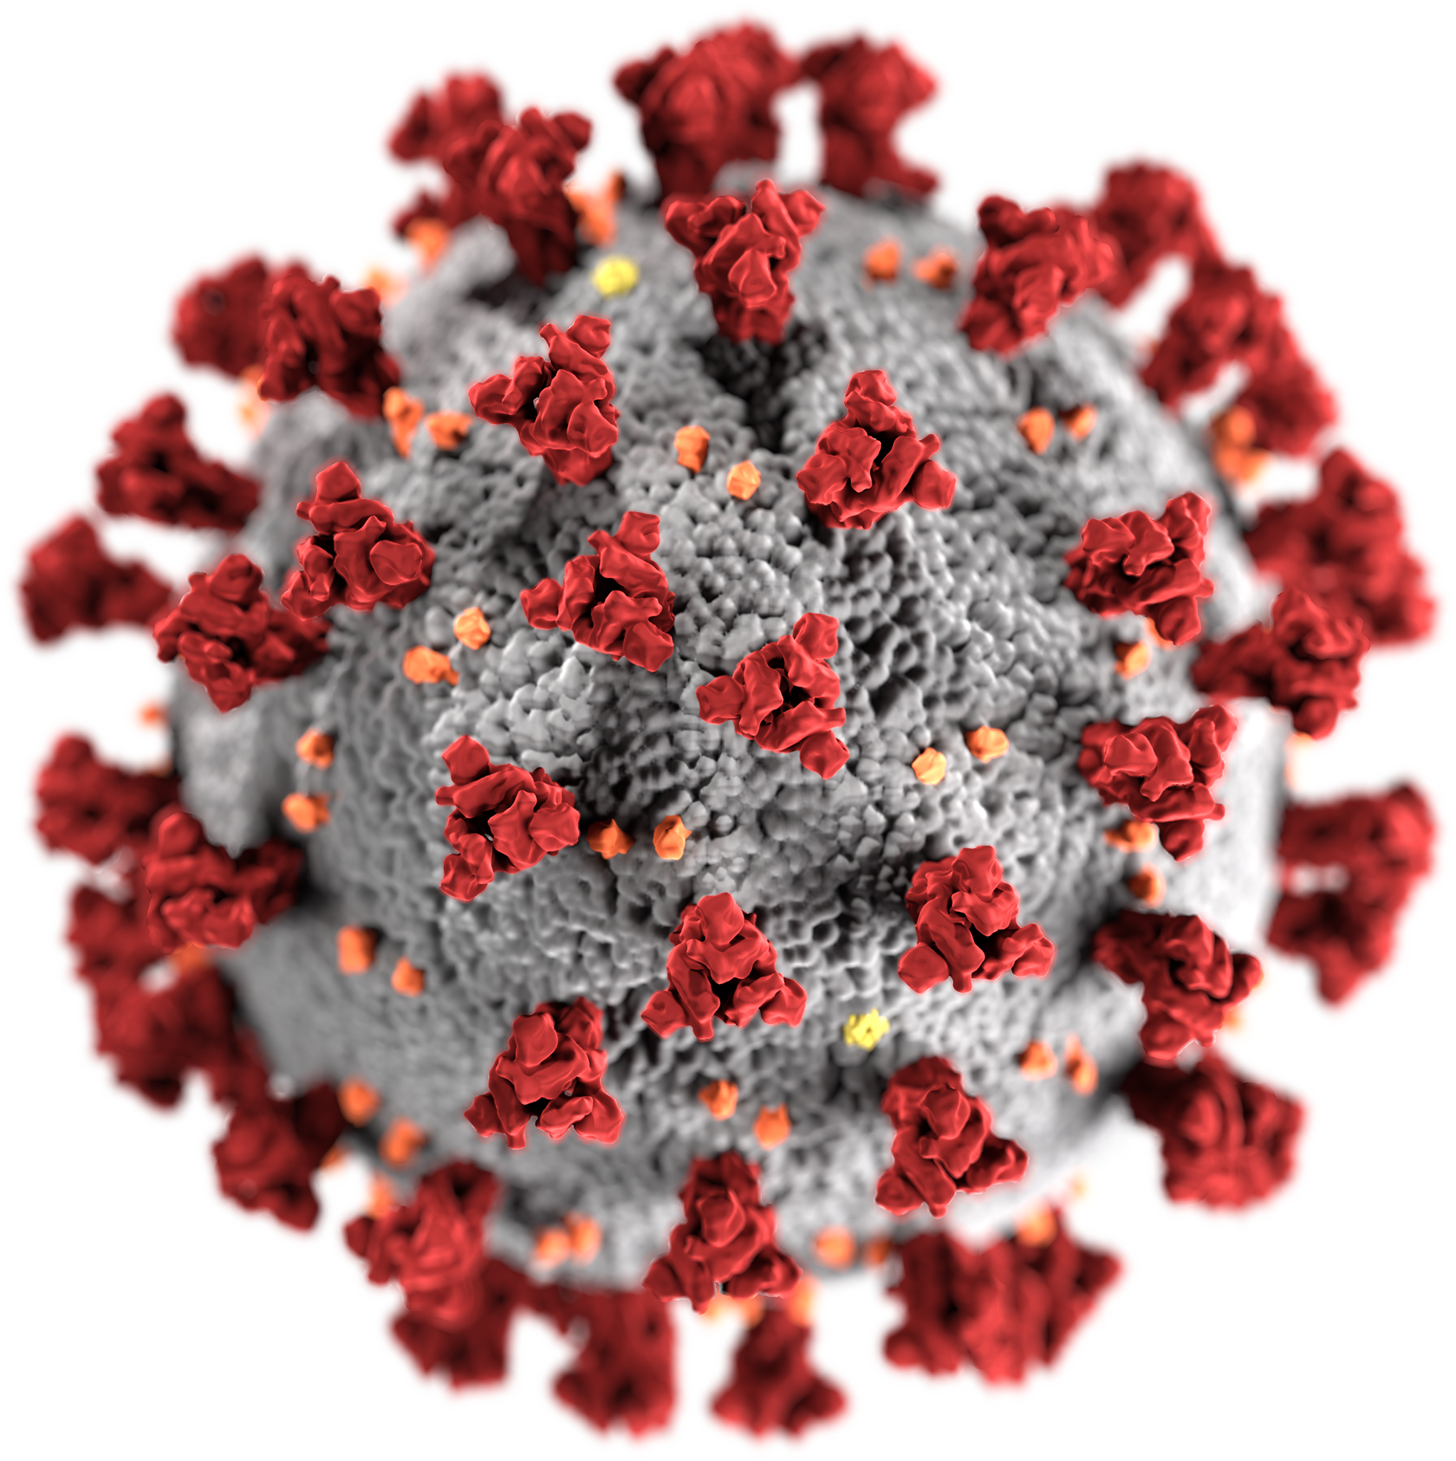
Week 2:
Overview about the main research topics connected to corona outbreak
Group: Quentin Quarantino

Slide 2
Topic 1: Spreading Models
Goal
To study the "...pathogenesis, spread regularity, and development trend of infectious diseases not only provides a theoretical basis for future research on infectious diseases, but also has practical guiding significance for the prevention and control of their spread"[1]
Application
calculation of public health interventions i.e. mass vaccinations
formation and implementation of national and global guidelines i.e. closing of schools
forecasting of infections and overall epidemic
Data Sources
traditional: World Health Orginization, John Hopkins, RKI etc.
assumptions: inference of existing populations, desease dynamics etc.
Challenges
model only as good as the assumptions made
trade-off between model complexity and feasability
population heterogenity, variablity of variates
[1]Bin S, Sun G, Chen CC. Spread of Infectious Disease Modeling and Analysis of Different Factors on Spread of Infectious Disease Based on Cellular Automata. Int J Environ Res Public Health. 2019;16(23):4683. Published 2019 Nov 25. doi:10.3390/ijerph16234683

Slide 3
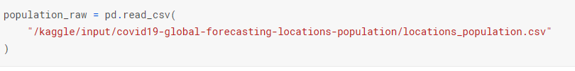
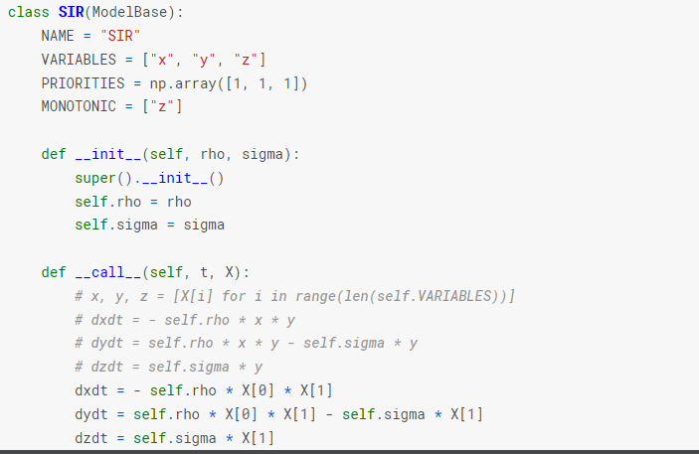
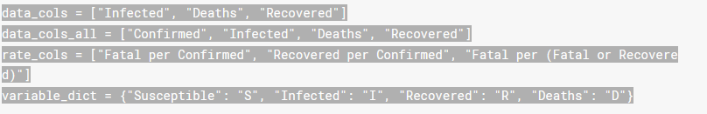
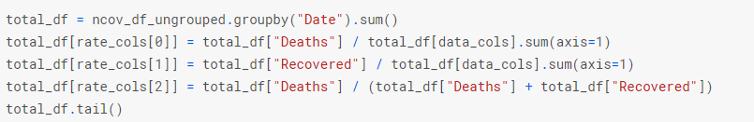
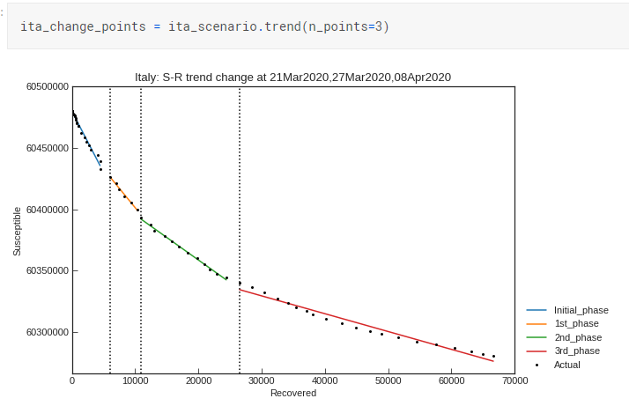
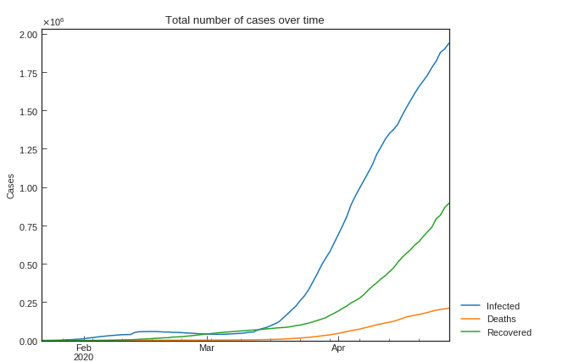
Topic 1: Spreading Models an Example (SIR)
3. Model selection and assumptions
1. Select Data/ Prepocessing
2. Exploratory Visual Analysis
4. Scenario analysis by case
https://www.kaggle.com/lisphilar/covid-19-data-with-sir-model#Grouping-by-growth-factor

Slide 4
Topic 2: Forecasting
Goal
Based on already recorded data predict the future behavior of the virus
Application fields
# of cases, deaths, recoverd people
end of the epidemic
Social and economical consequences
Data Sources
WHO
Statistical Offices (e.g. Hospital)
Challenges
Hidden number of cases (test capacity, gouvernment)
Finding and fitting the best model (parameter tuning)
Behavior of the virus is still not entirely explored (e.g. Transmission)

Slide 5
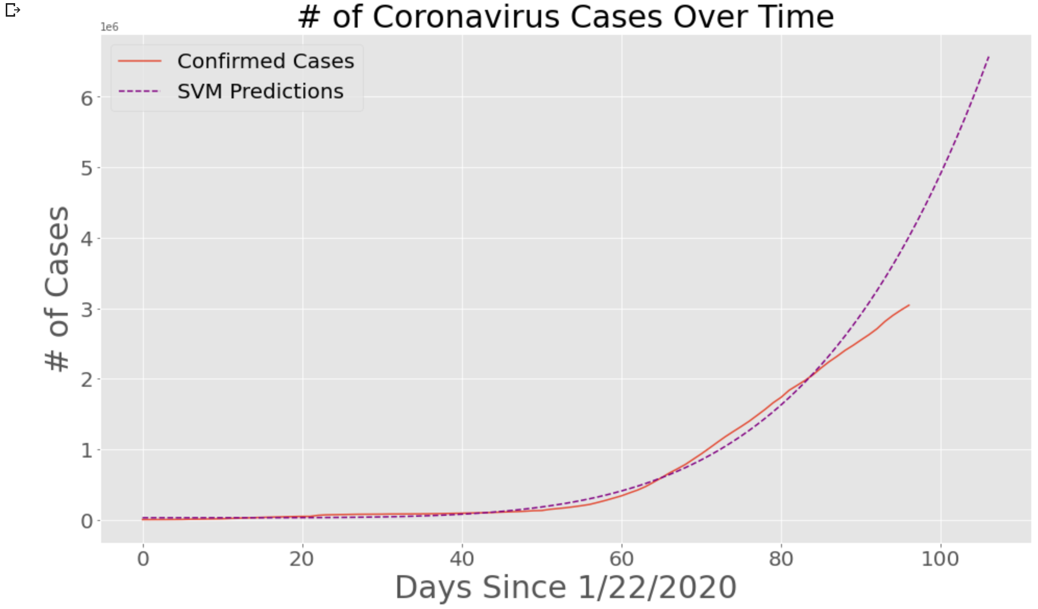
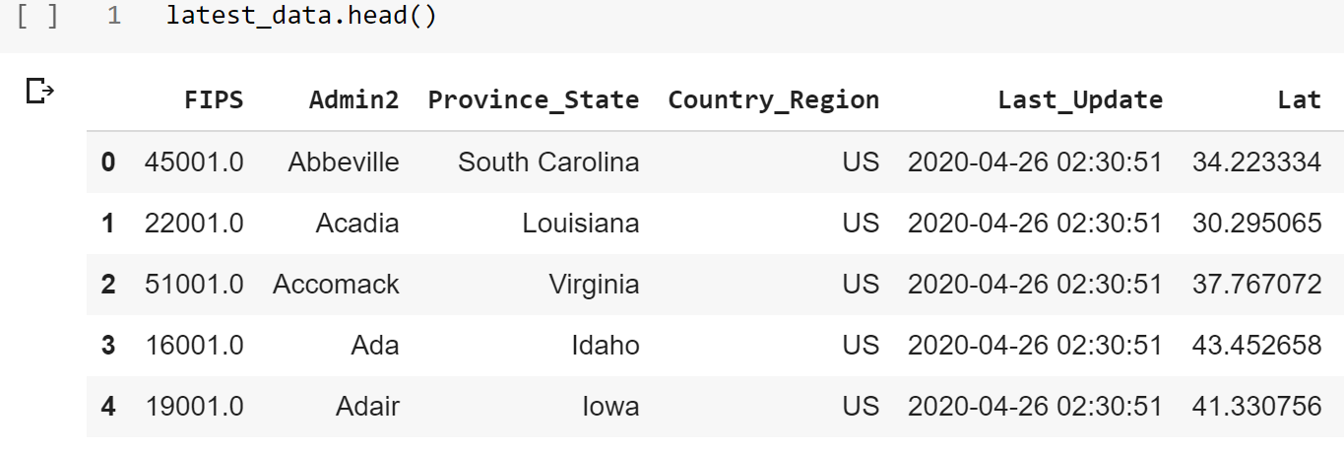
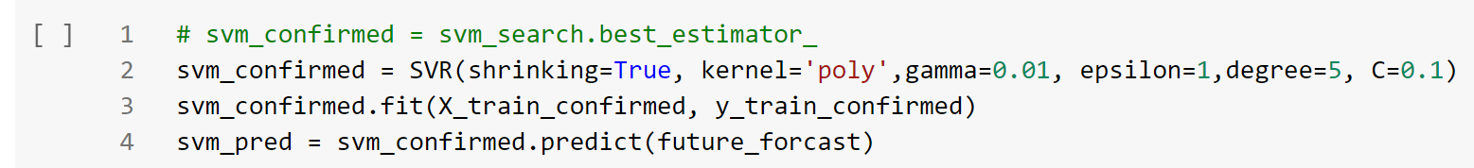
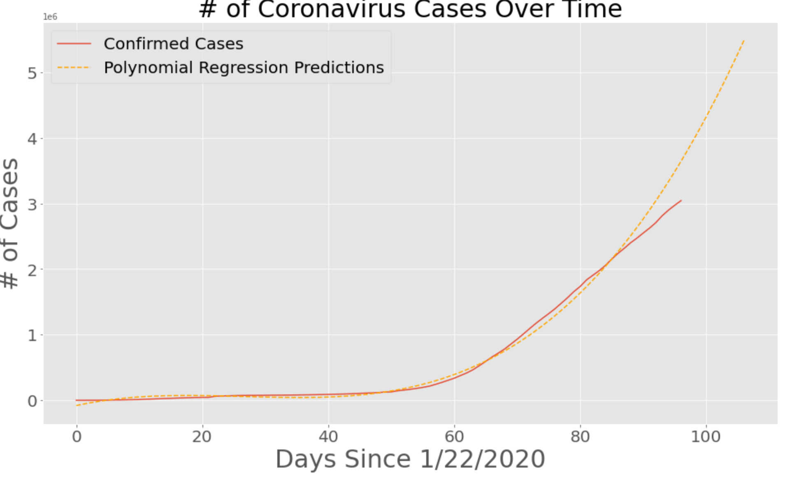
Topic 2: Forecasting
1. Selecting Data
3. Plot Results
2. Build Model
https://www.kaggle.com/lisphilar/covid-19-data-with-sir-model#Grouping-by-growth-factor

Slide 6
Topic 4: Risk factors Analysis
Goal
Quantifications of the outbreak risks and their dependencies on the key parameters for selected groups of countries from America, Asia, and Europe, representing a variety of country profiles.
Model Ingredients
(i) Estimate the cumulative number of cases in China outside Hubei province after 23 January, using a time-dependent compartmental model of the transmission dynamics.
(ii) Use that number as an input to the global transportation network to generate probability distributions of the number of infected travelers arriving at destinations outside China.
(iii) In a destination country, using a Galton–Watson branching process to model the initial spread of the virus. By calculating the extinction probability
Data sets/Collection
WHO, DXY

Slide 7
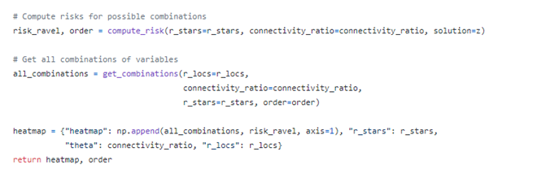
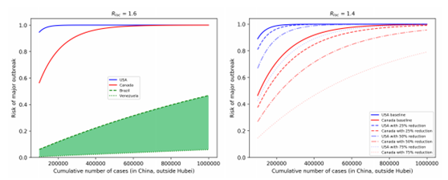
Risk of major outbreaks
1. Compute risks
Risk of major outbreaks as a function of cumulative number of cases in selected countries, assuming Rloc = 1.6 and baseline connectivity to China.
https://github.com/zsvizi/corona-virus-2020/blob/master/source/risk.py

Slide 8
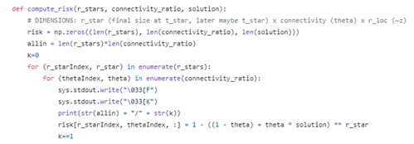
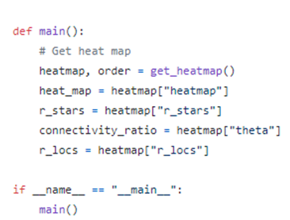
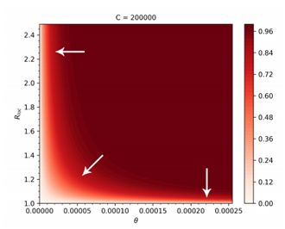
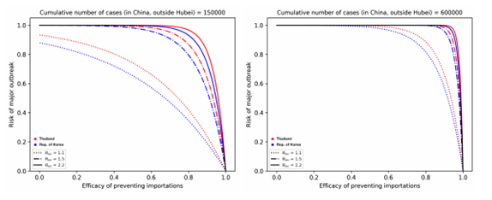
2. Get all the combination of risks
3. Generate Heatmap
Outbreak risks for highly connected countries in Asia. Thailand and the Republic of Korea are plotted; the curves for Japan and Taiwan are in between them. (Left). plot the risk vs. the efficacy of prevented importations when the cumulative number of cases reaches 150,000.
Heatmap of the outbreak risks as functions of θ and Rloc, when C = 200,000. The arrows show the directions corresponding to the largest reductions in the risk

Slide 9
Topic 5: Diagnostics
Goal: COVID-19 Detection from X Ray Images of Lungs
Applications: determination of pathology in lungs
Data Sources: X-Ray images of normal and pathological lungs
Challenges: Requires many X-Ray data for training the network, problem with one library TensorFlow

Slide 10
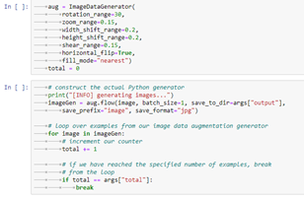
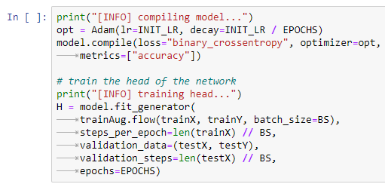
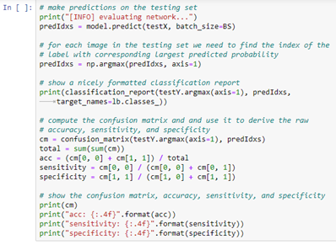
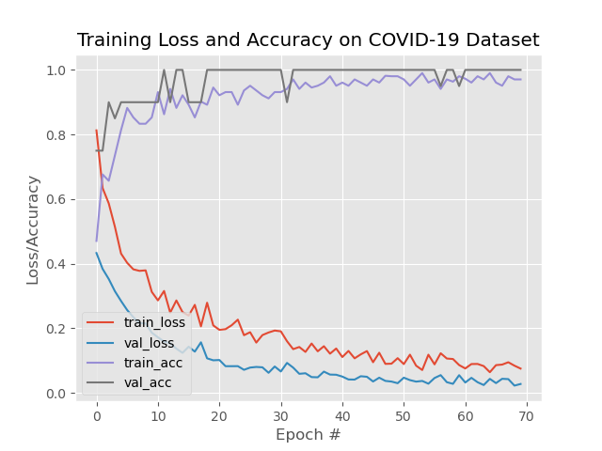
Pipeline workflow
Generate images with defined parameters:
Training network using training data set
Evaluation of Accuracy of the network using testing data
Vizualization results

Slide 11
Topic 3: Pholygenetic Analyis
Goal Examine the evolutional change of the virus RNA and the determination of relationsips
Applications
Define common origin
Reconstruction of geographic spread
Estimate mutation rate
Data Sources
SARS-CoV-2 genomes (e.g. GISAID database, GeneBank ...)
Challenges
Requires many complete SARS-CoV-2 genomes
Memory efficient

Slide 12
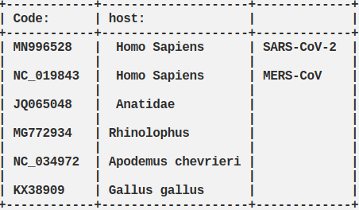
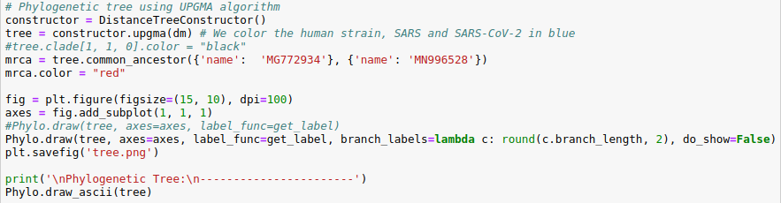
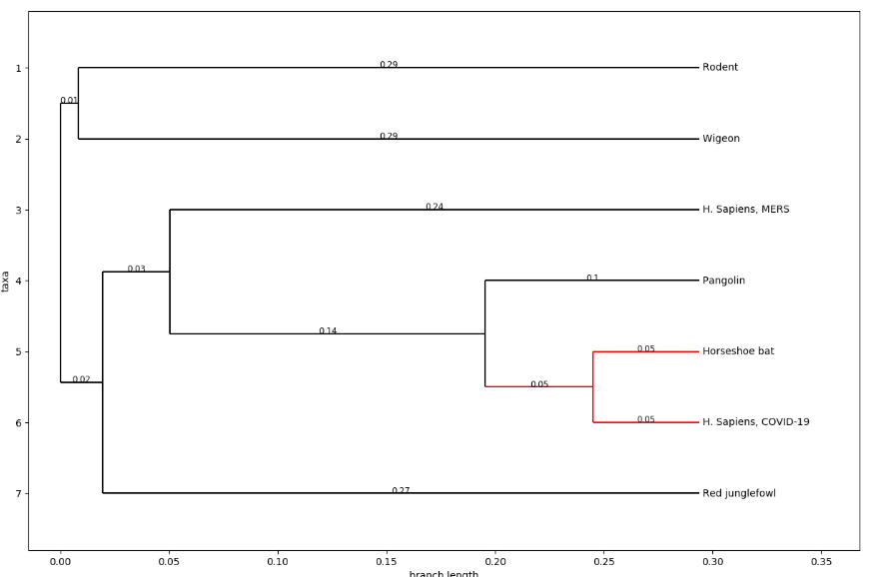
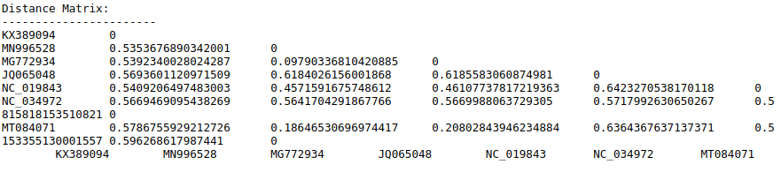
Phylogenetic Analysis: Origin Detection
1. Selecting Data
4. Create Phylogenetic Tree
2. Alignment
3. Distance Calculation
Code: https://github.com/simonjuleseric2/covid_sequence

